Slide 1


Slide 2
ARRIVAL IN ITALY
For all Delegates: Molecular test (PCR) carried out 48h before arrival in Italy (Recommended)
Mandatory Passenger Locator Form
Temporary address: Camera dei deputati-COP26
Delegates from non-EU countries
Antigenic swab test inside the airport
If positive Competent Italian Health Authorities
Transfer to the city: taxi, hire car or private vehicle
PLEASE INFORM US ON TRAVEL PLAN, HOTEL AND DELEGATION FOCAL POINT
(Form 1) by 29 September
protocol.romecop26@camera.it

Slide 3
LANGUAGES
5 languages
Arabic, English, French, Italian and Spanish
Number of booths on a first-come-first-served basis bringing own interpreters
Deadline: 29 September 2021
E-mail request to: interpreti@camera.it

Slide 4
REQUEST FOR FLOOR
1 Delegate per House of Parliament, just once during the whole conference
Indicate 2 Options in total and in order of priority
Speaking time: 2 minutes
Deadline: 29 September 2021
Use Form 2
Register romacop26@camera.it
Written speeches interpreti@camera.it
Speakers’ list circulated in due time

Slide 5
BILATERAL MEETINGS
10 people per room
30 minutes per meeting
Two meetings per day
Slots:
Friday, 8 October: 1.30 pm / 2.15 pm / 4.30 pm / 5.15 pm / 6.00 pm
Saturday, 9 October: 2.00 pm / 2.45 pm / 3.30 pm / 4.15 pm / 5.00 p.m.
Deadline: 29 September 2021
E-mail request to: radoni_s@camera.it

Slide 6
BADGES
All registered participants have to wear their badges and carry an identity document with photo
Color of badges:
MPs: Green
Keynote speakers and moderators: Red
Staff: Blu
Media: Yellow
Interpreters: Grey
Badges will be handed out after Covid testing
They will be indicating name, surname and country (in English)

Slide 7
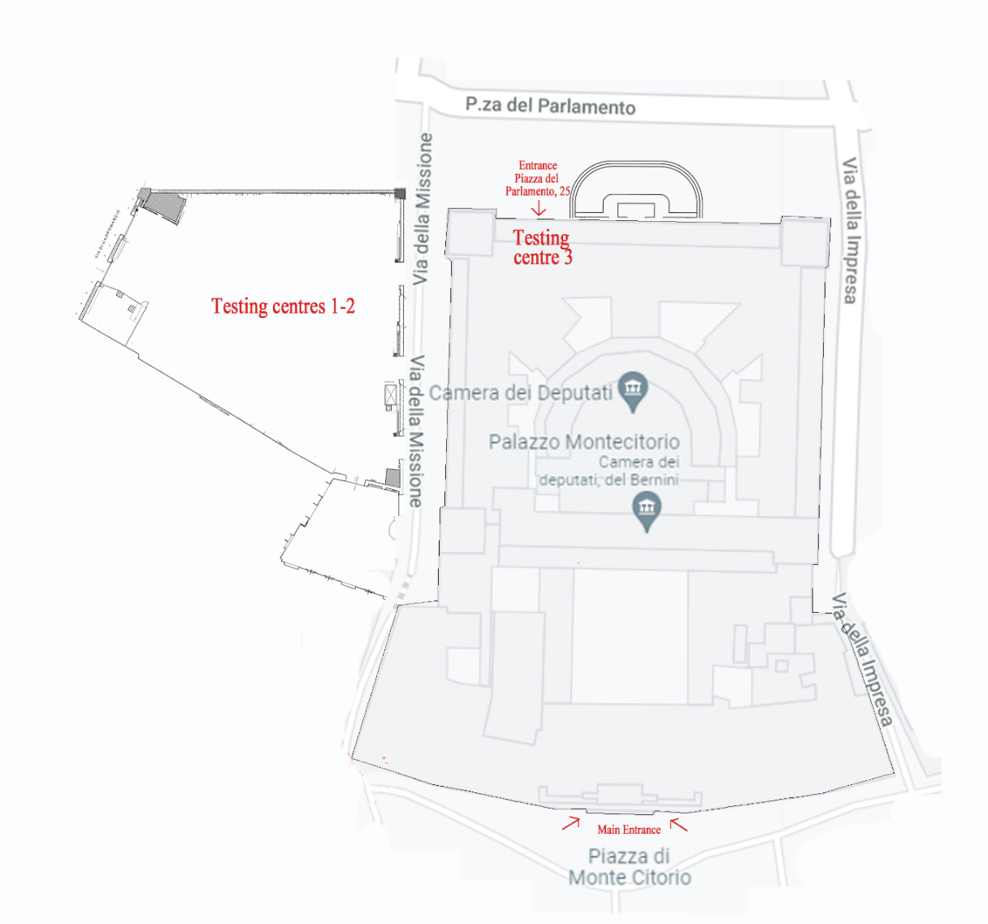
HEALTH MEASURES - 1
All participants will be asked to undergo an antigenic swab test before entering the Chamber of Deputies
3 facilities
Delegations have been divided into three groups and assigned to a site as follows:
Parking lot n. 1 : Afghanistan to Hungary
Parking lot n. 2: Indonesia to Romania
Piazza del Parlamento n. 25: Saudi Arabia to Zimbabwe and Arab Parliament - IPU - OSCEPA - PABSEC - PAM - Parlatino
Booking is mandatory via https://covidtest.camera.it. The site opens on 4 October 2021 at 10 am (CEST) and closes on 7 October at 12 am (CEST)

Slide 8
HEALTH MEASURES - 2
Testing on 8 October has been divided into four time slots:
8 am - 10 am
10 am - 12 pm
12 pm - 2 pm
3 pm. onwards
Tests are carried out on a first-come-first-served basis within each time slot.
Testing for COVID 19 in one of the three sites indicated is mandatory and only a negative result will allow participants to receive a badge to enter the Chamber of Deputies
Delegates who haven’t taken a test in the indicated sites will not be admitted to the premises of the Chamber of deputies

Slide 9
HEALTH MEASURES - 3
In case of positivity:
The person will be submitted immediately to a molecular PCR test, and will be brought to a facility where he/she must remain pending the outcome of this second test
if the result of the second test confirms positivity to the virus, the person concerned will be assisted by the competent health authorities.
Once you have received your badge you may enter the Chamber of Deputies starting from 1 pm of 8 October
All delegates will be given an FFP2 mask
A specific insurance policy against the risks of SARS-CoV-2 infection is recommended

Slide 10
DINNER AT THE NATIONAL GALLERY
OF MODERN ART 8 October 2021
Invitees: only registered MPs with negative COVID-19 test (including one registered accompanying interpreter per House)
Departure by bus from Piazza Montecitorio right after the end of the meeting
When boarding on buses, MPs need to show their badge
Free visit of the exhibition "Cosmowomen. Places as Constellations” followed by buffet dinner, free seating
Dress code: Business attire
+/- h. 11 pm End of the dinner and departure by bus to Piazza Montecitorio
+/- h. 11.30 pm Arrival at Piazza Montecitorio
Please inform us by 29 September about any dietary restrictions

Slide 11
PAPAL AUDIENCE
Vatican City, 9 October 2021
All registered participants with negative COVID-19 test are invited.
All participants have to wear their badges and carry an identity document with photo
Departure by bus
h 9.00 Meeting in Piazza Montecitorio
h 9.30 Departure
h 10.00–11.00 Free visit of Saint Peter’s Basilica
h 11.30-12.30 Papal Audience in Paul VI Audience Hall
Access to the Vatican will only be possible with transportation organized by the Chamber of Deputies

Slide 12
P20 PARTICIPANTS
On 7 and 8 October the P20 Summit will take place in the Italian Senate
One P20 participating Speaker + 2 staff members per House are invited to attend the PRE COP26 Meeting of 8 and 9 October 2021
P20 participating Speakers who have been Covid-19 tested on 7 October, need to be tested again on 9 October, before leaving for the Papal Audience
Testing will take place in the same areas, starting from 8.00 o’clock on Friday, 9 October
After this test, the P20 participating Speakers will receive a new badge

Slide 13
ARRIVEDERCI A ROMA

