Slide 1
The first
Global Refugee Forum, as part of implementing the Global Compact on Refugees
African Regional Parliamentary Conference:
Comprehensive Responses to Refugee Situations – Effective Parliamentary Approaches
Midrand,11 November 2019
Mamadou Dian Balde
Deputy Director
Division of Resilience and Solutions
UNHCR Headquarters

Slide 2
What will we be discussing?
1st Global Refugee Forum: 17-18 December 2019
Prioritized areas
Examples of recent policies operationalizing the Global Compact on Refugees
Examples of support provided to refugees and refugee hosting areas
Tools and resources

Slide 3
GLOBAL REFUGEE FORUM
Laying the foundation for the longer- term implementation of the GCR
Organized every 4 years at ministerial level
  High-level official meetings every 2 years in-between
1st GRF in Geneva, 17-18 December 2019
Pledges, contributions and good practices

Slide 4
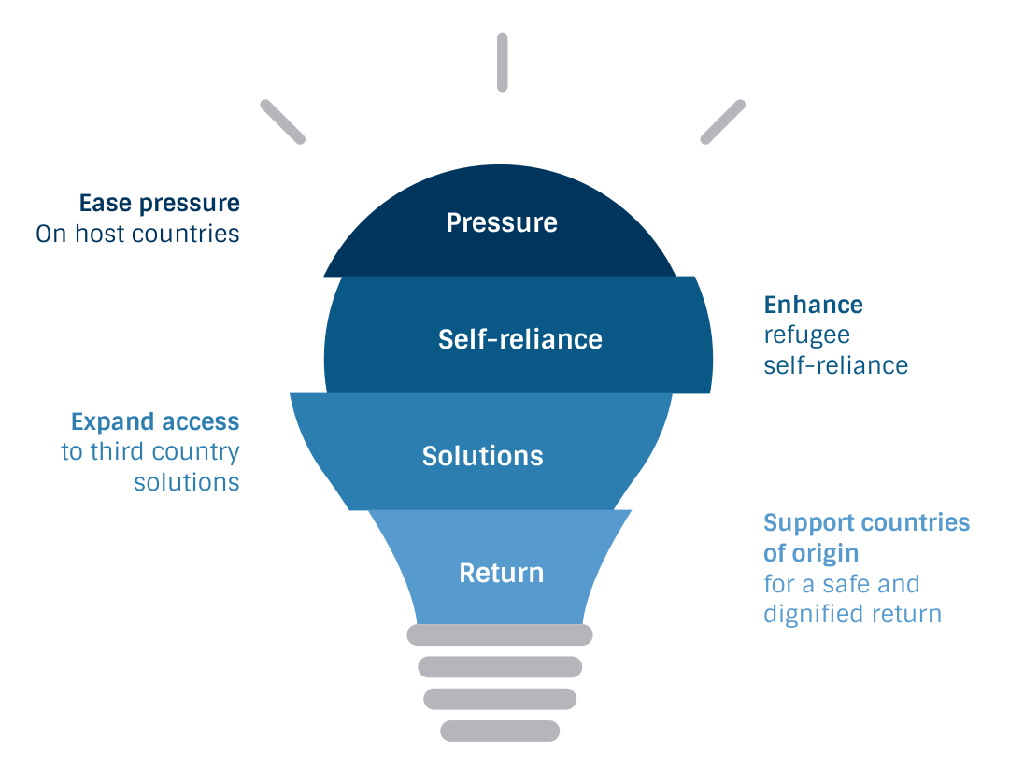
FOUR INTERLINKED AND INTERDEPENDENT OBJECTIVES
Notes:
Para 7

Slide 5
6 AREAS OF FOCUS
Burden and responsibility-sharing
Education
Jobs and livelihoods
Protection capacity
Solutions
Energy and infrastructure

Slide 6
10 HIGH-LEVEL OUTCOMES
Broaden & deepen the base of support (new donors)
Inclusive national policies in 20 host countries
Launch 2 Support Platforms
Additional/ new funding for refugee responses
Expand access to secondary/ tertiary education
Sustainable/ green energy
Private sector investments, employment, innovation, advocacy & philanthropy
Additional support for voluntary repatriation and reintegration; local integration; and the 3 year RST Strategy
Launch Asylum Capacity Support Group
Launch Global Academic Network

Slide 7
PLEDGES AND CONTRIBUTIONS
Guided by objectives of GCR, areas of focus, and high level outcomes
Do not need to be directed towards UNHCR
Can include:
  - Commitments and advocacy
  - Financial, material, and technical assistance
Can be made:
  - At national, regional or global levels
  - By States and other stakeholders
  - As individual, joint or matching pledges

Slide 8
PARTICIPATION
Co-hosts
Co-convenors
UN Secretary-General
States & other stakeholders
Refugees
Co-sponsorship groups
Regional & country consultations

Slide 9
PARTICIPATION (2)
High-level dialogues
Statements from the floor
Spotlight sessions
Speakers’ corner
Digital portal
Media interviews
Marketplace exhibits

Slide 10
Tools and indicators to measure progress
Development of GCR indicators
Measuring the impact of hosting, protecting and assisting refugees

Slide 11
EXAMPLES OF LEGISLATIVE AND POLICY CHANGE
Continental
African Union 5th Annual Humanitarian Symposium on the GCR and the Comprehensive Refugee Response Framework (Nairobi, November 2017)
African Union Executive Council Decision (Jan. 2018): requests Member States to include refugees, IDPs and persons at risk of statelessness into civil registration and vital statistics systems (EX.CL/Dec.988(XXXII)rev1)
African Union Year 2019 on refugees, internally displaced persons and returnees

Slide 12
EXAMPLES OF LEGISLATIVE AND POLICY CHANGE (2)
Regional
IGAD Nairobi Declaration & Plan of Action (March 2017): regional comprehensive refugee response that combines efforts of countries of asylum and origin
IGAD thematic declarations and action plans on education (2017) and jobs and livelihoods (2019) promoting inclusion of refugees, while seeking international responsibility-sharing and easing the burden on host countries
Roadmap on Ivorian refugee situation (2018), Abuja Action Statement on Lake Chad Basin Situation (2019), Kampala ministerial statement on Great Lakes region (2019)
SADC engagement in Southern Africa

Slide 13

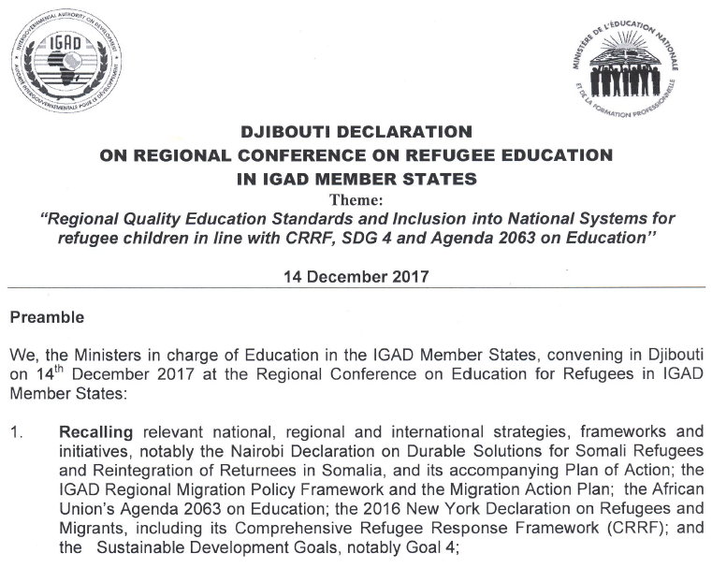
Interphase between national and regional efforts
Notes:
Example: how these two interlink

Slide 14
EXAMPLES OF LEGISLATIVE AND POLICY CHANGE (3)
National
Ethiopia:
  New refugee law (2019) in line with enactment of 2016 Leaders’ Summit commitments – gradual out of camp policy, access to work, national service delivery
  Amendment of Vital Events Registration Agency Proclamation (2017) to include refugees
Djibouti:
  new refugee law (2017) and two decrees for implementation:
  Sector-specific MOUs between government and partners to guide implementation of refugee inclusion e.g. in health, education
Zambia: 2017 new refugee law with more progressive provisions, policy under preparation

Slide 15
Examples of predictable support offered to refugee hosting areas: for hosts and refugees
World Bank’s IDA18 sub-window for refugees and host communities - $2 billion (June 2017- July 2020)
Support by other Multilateral Development Banks: African Development Bank, Asian Development Bank, Islamic Development Bank, etc
Bilateral support by institutions such as JICA, SIDA, DEVCO, GIZ, etc
Partnership with private sector engagement, such as national and regional chambers of commerce, private companies, to support both refugees and hosts.

Slide 16
For more information …
Global Compact on Refugees: full text in English , French + website
Website on the Global Refugee Forum with all documents issued
  Guidance note on pledges, contributions and good practices
“Highlights of progress towards comprehensive refugee responses since the adoption of the New York Declaration” (2019)
2-year progress assessment of the CRRF approach (2018)

Slide 17

TO BE LAUNCHED AHEAD OF THE 1ST GRF:

Slide 18
End
Questions and Comments

